Slide 1
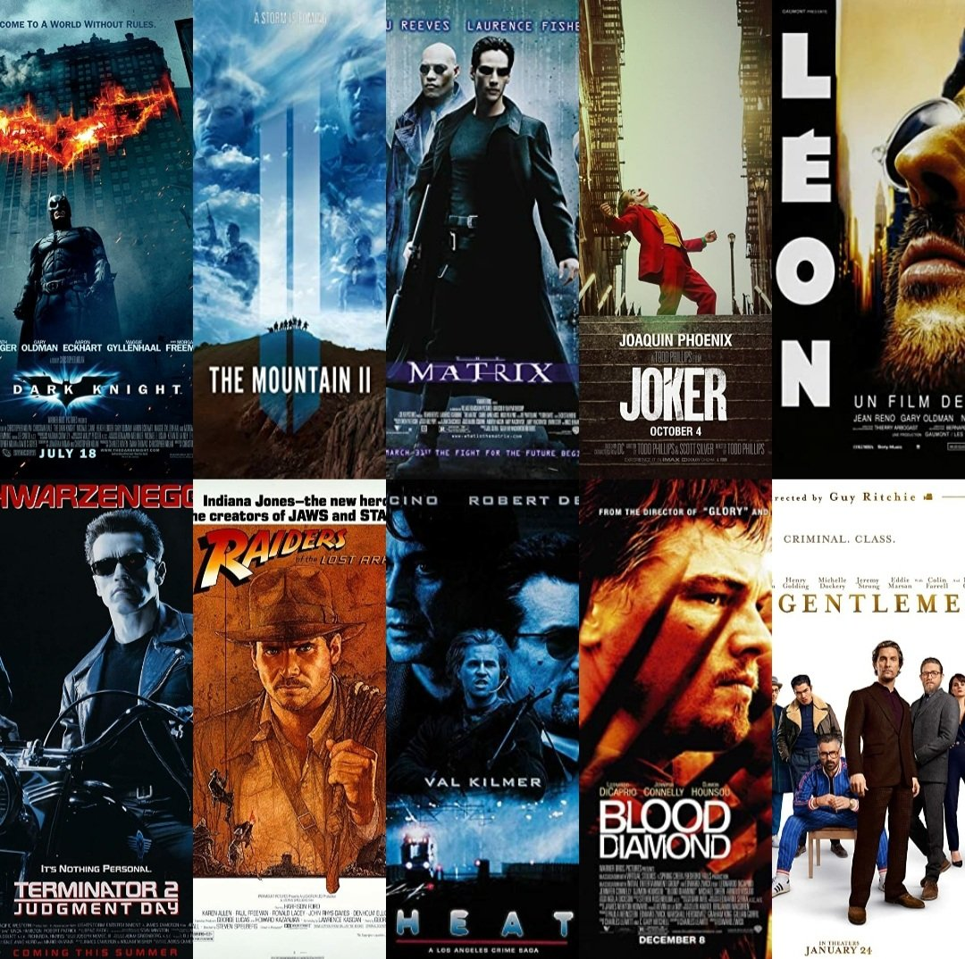
IMDB's Top 100 Action movies
Andrea | Kingsley | Islom

Slide 2
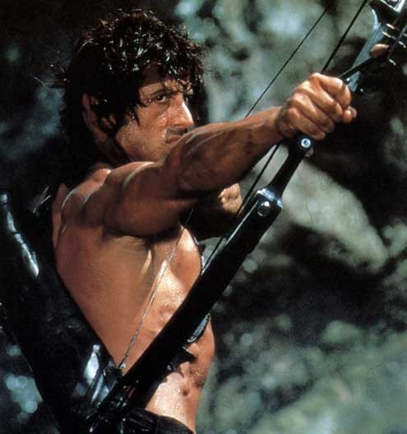
Goal
The main goal of the project is to suggest the best action movies to watch this night in the IMDB’s Top 100 movies. We decided to sort them by release date and rating.
Andrea | Kingsley | Islom

Slide 3

Methodology
1) Scraping from IMDB using BeatifulSoup
Movie name
Description
Release Date
Director Name
Rating
Duration
Genre
Stars (Actors)
Filming Dates
2) Processing them with Pandas Dataframe
Load a dataset
Explore data
Describe data
Identify missing values
Export the dataframe to CSV file
3) Data visualization with MatPlotLib
Andrea | Kingsley | Islom

Slide 4
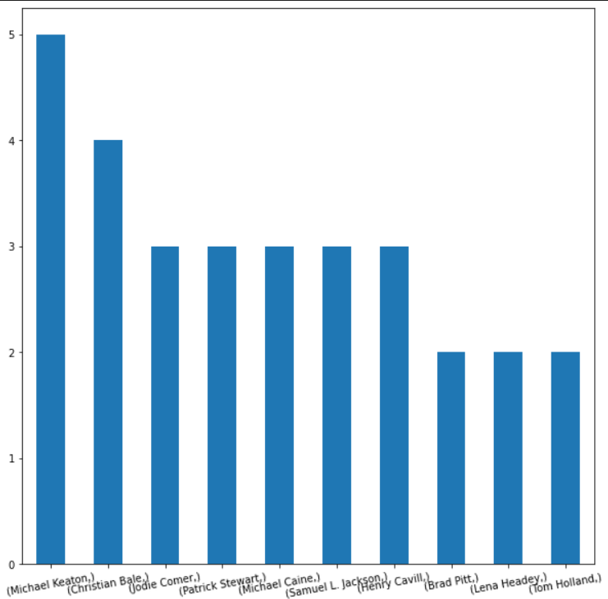
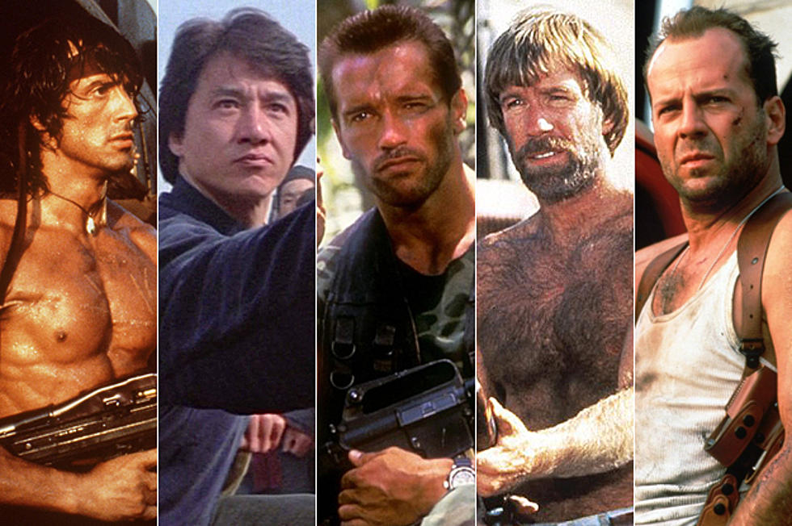
Preliminary results
Top 10 Actors
Andrea | Kingsley | Islom

Slide 5
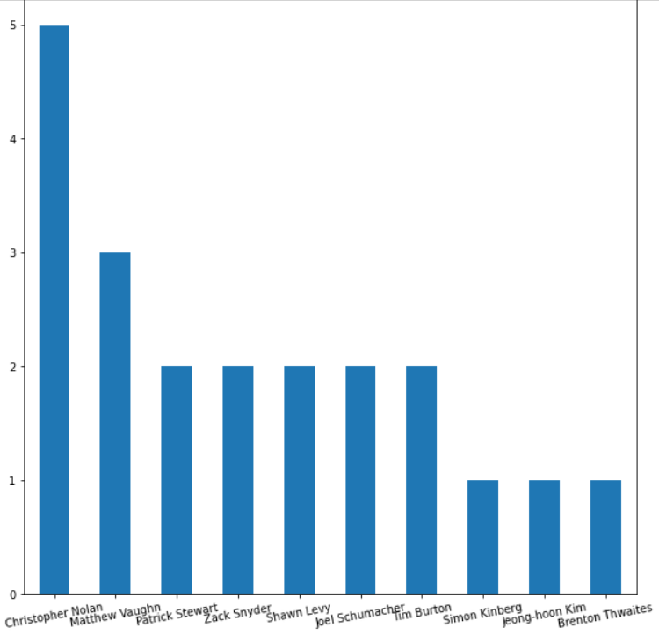
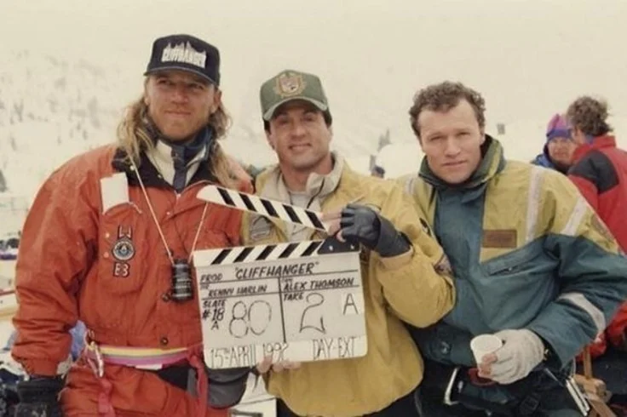
Preliminary results
Top 10 Directors
Andrea | Kingsley | Islom

Slide 6
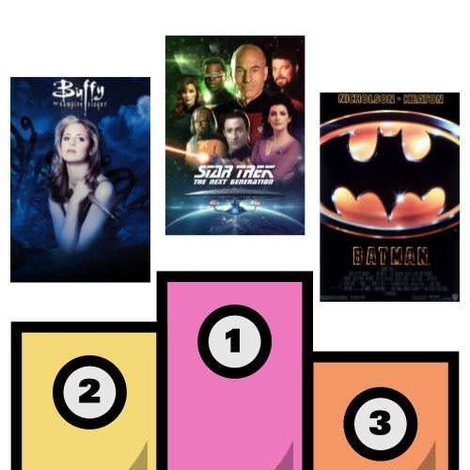
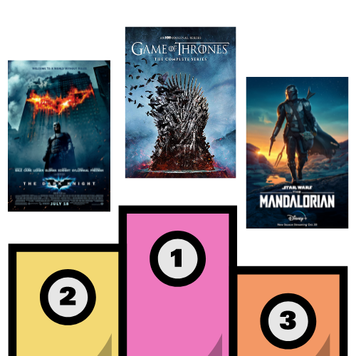
Our suggestions for this night
If you are in an 80’s or 90’s mood…
If you love the 00’s or 10’s…
Andrea | Kingsley | Islom

